Slide 1
3. System reliability
Objectives
Learn the definitions of a component and a system from a reliability perspective
Be able to calculate reliability of series, parallel and complex systems given the reliabilities of their components

Slide 2
Definition of components and systems
Component: One failure mode, one performance function
System reliability: multiple failure modes, multiple performance functions
Block diagram: Shows effect of the failures of the components on the failure of the system

Slide 3
Series system
Calculation of reliability
System fails if any one of its components fails
1
2
…
n
Independent components
R_{S}=R₁⋅… ⋅ R_{n}

Slide 4
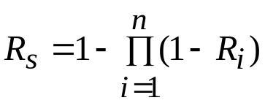
Parallel system: calculation of reliability
System survives if one component survives
1
2
n
3

Slide 5
Generic approach for reliability analysis of complex systems
List all possible modes
Break down the event “system failure” into disjoint events
Calculate the failure probabilities of these events
System failure probability equals the sum of probabilities of the above events.

Slide 6
Suggested reading
Thoft-Christensen, “System Reliability,” Engineering Design Reliability Handbook, CRC press, 2004, p. 15-1.

